Slide 1
GCBASIC
PIC18FxxQ35chip Family
Part 10 - EEPROM Operations

Slide 2

GCBASIC
PIC18FxxQ35chip Family
Part 10 - EEPROM Operations

Slide 3
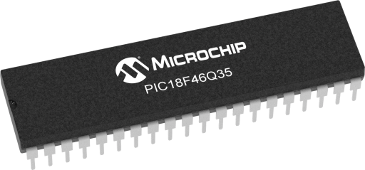
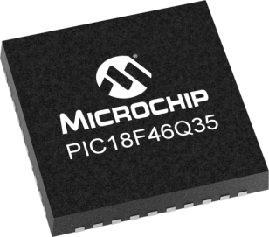
GCBASIC
Like and subscribe!

Slide 4
PIC18FxxQ35
PIC18FxxQ35 is a high performance PIC18
Digital and analog peripherals for flexible embedded control
10-bit ADC for accurate analog signal conversion
Multiple communication interfaces including UART (serial), I²C, and SPI
PWM modules with CCP and 16-bit resolution for precise timing and motor control
Configurable Logic Cells (CLCs) for custom hardware-level logic without external components
Integrated op amps for onboard analog signal conditioning and amplification
The PIC18FxxQ35 offers 28, 40 and 44-pin products in small footprint packages to support customers in a wide variety of applications.

Slide 5
Videos...
Install the hardware and make the board work – make LEDs work
Make four LEDs flash in a sequence
Set the LEDs to represent the value of ADC
Sequence the LEDs with a delay using the value of ADC
Using an input to set the state of the LEDs
Using the reset switch
Using the switch, ADC – make the LEDs flash in a sequence with reverse
Using the serial to display values
Using the timer0 overflow, 8bit timer, 16bit timer to flash the LEDs
Using EEProm – showing values on the serial terminal, and more constants insights
Using I2C with serial to discover I2C devices
Using an I2C GCLD display
Using a SPI GCLD display
Using PWM, many ways, to dim the LEDS
Using an external interrupt to control an LED
Using storage within the chip – Progmem, SAF memory, EEPROM and DATA blocks
Using CLC
The GCBASIC tool chain
Assembly , alternatives assemblers and MPLAB-X
Summary

Slide 6
GCBASIC Compiler
GCBASIC Compiler
GCBASIC is an Open Source compiler for PIC, AVR and LGT microcontrollers
GCBASIC now supports the 18FxxQ35 chip family
GCBASIC now supports 1400+ microcontrollers

Slide 7
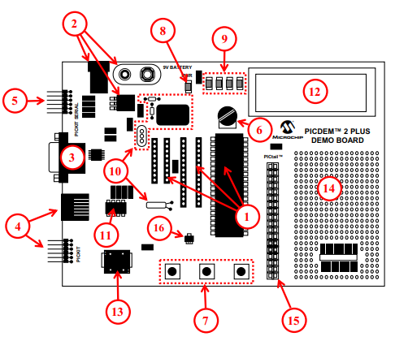
PICDEM 2 Plus Demonstration
Board
1. 18-, 28- and 40-pin DIP sockets
(although three sockets are provided, only one device may be used at a time)
2. On-board, +5V regulator for direct input from 9V, 100 mA AC/DC wall adapter or 9V battery, or hooks for a +5V, 100 mA regulated DC supply
3. RS-232 socket and associated hardware for direct connection to an RS-232 interface
4. Programmer/debugger connectivity supporting MPLAB® ICD 3, MPLAB REAL
ICE and PICkit 3
5. PICkit Serial Connector for analysis of serial communications peripherals such as SPI or I2C™
6. 5 k pot for devices with analog inputs
7. Three push button switches for external stimulus and Reset
8. Power-on indicator LED
9. Four LEDs connected to PORTB
10. On-board external oscillators including:
a) Unpopulated DIP socket for canned crystal oscillator (Y2)
b) RC oscillator circuit (R4, C3)
c) Unpopulated holes for crystal connection (Y1)
d) 32.768 kHz crystal for Timer1 clock operation (Y3) 11. 32K x 8 Serial EEPROM
12. LCD display
13. Piezo buzzer
14. Prototype area for user hardware
15. Expansion Header for PICtail™ daughter card connectivity or user access to
MCU pins
16. Microchip TC74 thermal sensor
3A

Slide 8
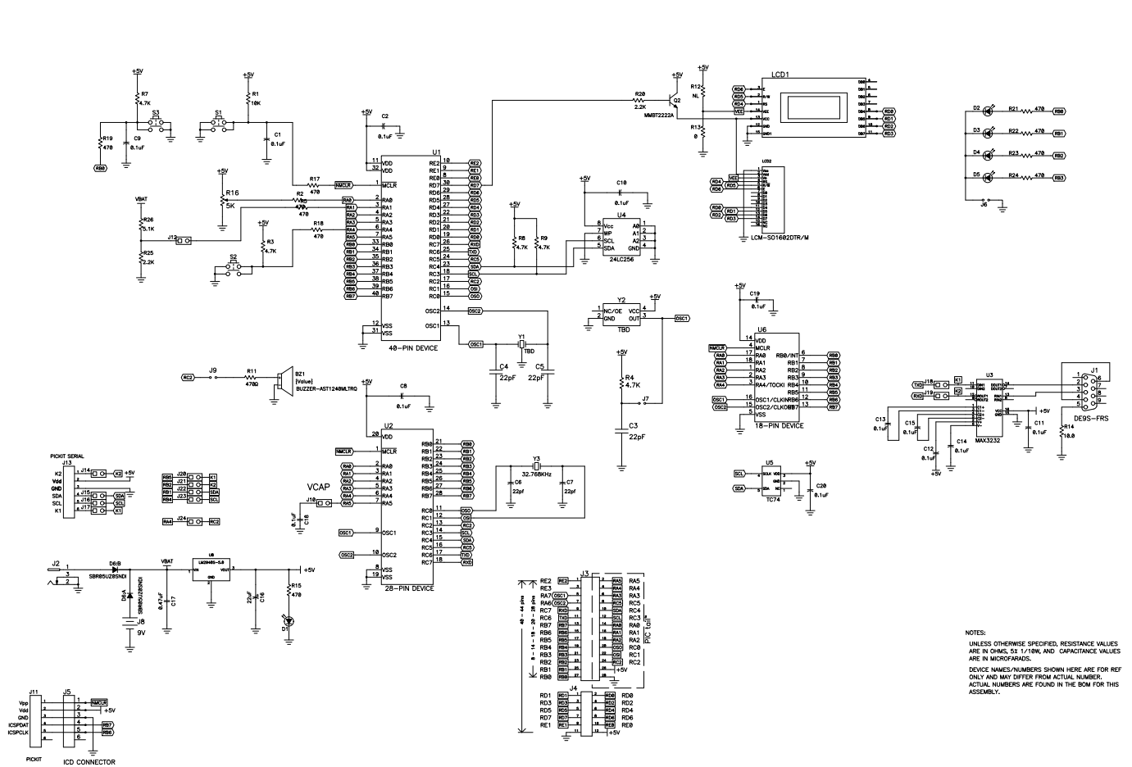
PICDEM 2 Plus Demonstration
Board

Slide 9
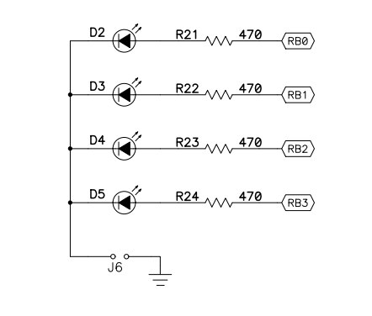
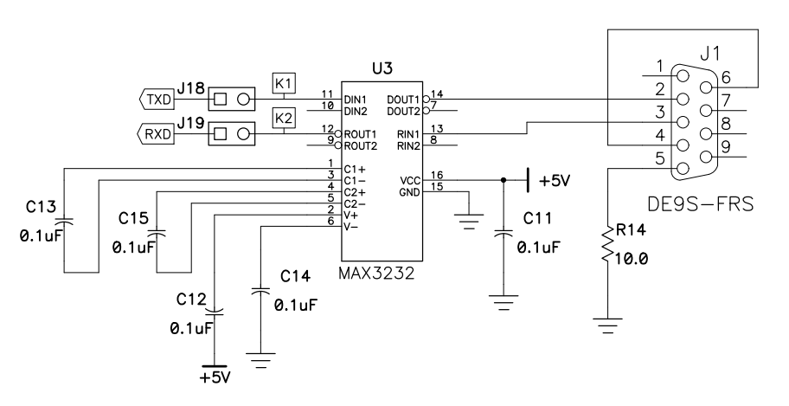
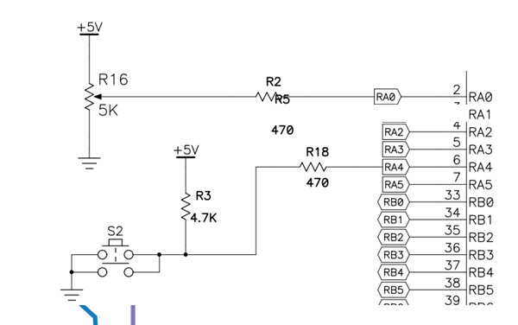
Schematic
USART TTL SIGNAL

Slide 10
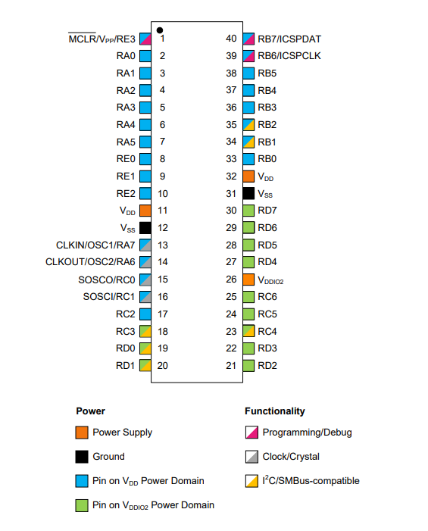
VDDIO2 Domain Power
Think No VDDIO2 power – no domain I/O!

Slide 11
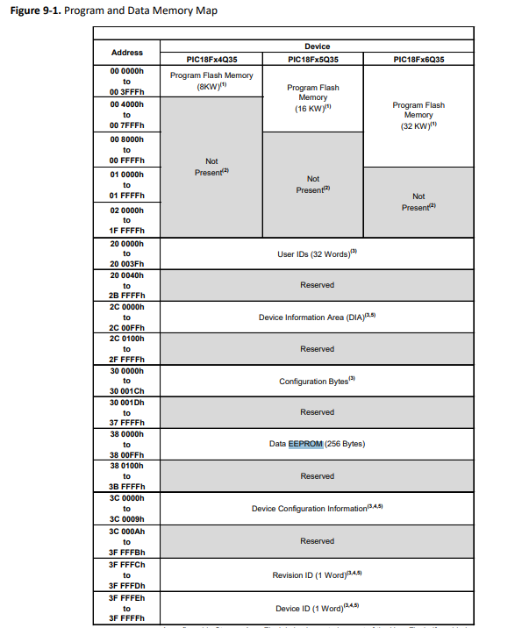
Memory
Program Flash Memory ( PFM )
Data SRAM Memory
EEPROM 256 Bytes
Memory Access Partition, the Program Flash Memory Partitioned into:
Application Block
Boot Block
Storage Area Flash (SAF) Block

Slide 12
EEProm
Electrically Erasable Programmable Read-Only Memory
Non-volatile memory to store relatively small amounts of data but allowing individual bytes to be erased and reprogrammed.

Slide 13
EEProm
Type Value Explanation
Prog 16384 Prog is exposed as ChipWORDS
SAFMemWords 128 SAFMemWords exposed ChipSAFMemWords
EEPROM 256 EEPROM is exposed as ChipEEPROM
RAM 2048 RAM is exposed as ChipRAM

Slide 14
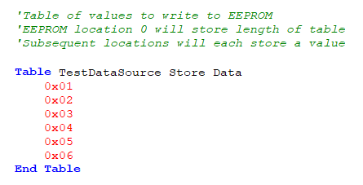
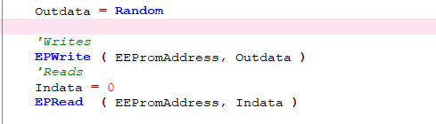
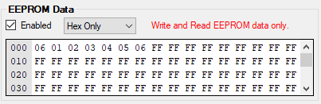
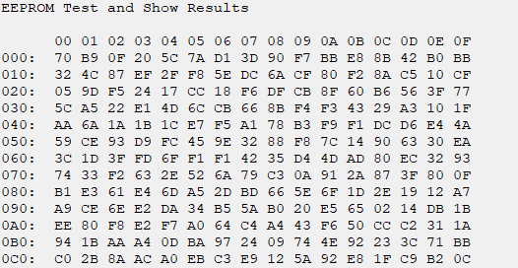
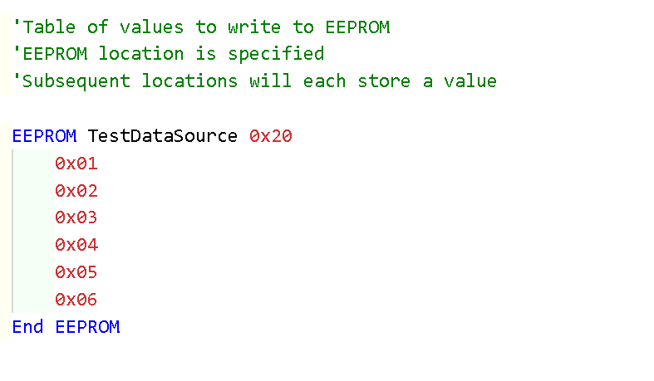
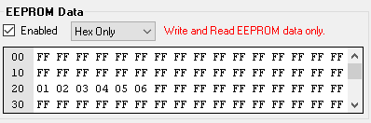
EEProm – 3 ways

Slide 15
Lab
Sample code – write and read via terminal
Using PPS select the serial USART port
Write values to EEProm
Read values to EEProm
See the results on terminal
Sample code – write with read via programmer
Write values to EEProm
See the results within PICKitPlus
Sample code – check the chip specific constant
See the results on terminal

Slide 17
Videos...
Install the hardware and make the board work – three LED programs
Make four LEDs flash in a sequence
Set the LEDs to represent the value of ADC
Sequence the LEDs with a delay using the value of ADC
Using an input to set the state of the LEDs
Using the reset switch
Using the switch, ADC – make the LEDs flash in a sequence with reverse
Using the serial to display values
Using the timer0: 16bit timer, 8bit timer and overflow to flash the LEDs
Using EEProm – showing values on the serial terminal, and more constants insights
Using I2C with serial to discover I2C devices
Using an I2C GCLD display
Using a SPI GCLD display
Using PWM, many ways, to dim the LEDS
Using an external interrupt to control an LED
Using storage within the chip – Progmem, SAF memory, EEPROM and DATA blocks
Using CLC
The GCBASIC tool chain
Assembly , alternatives assemblers and MPLAB-X
Summary

Slide 18
GCBASIC
PIC18FxxQ35chip Family
Part 10 - EEPROM Operations

